Slide 1


Slide 2
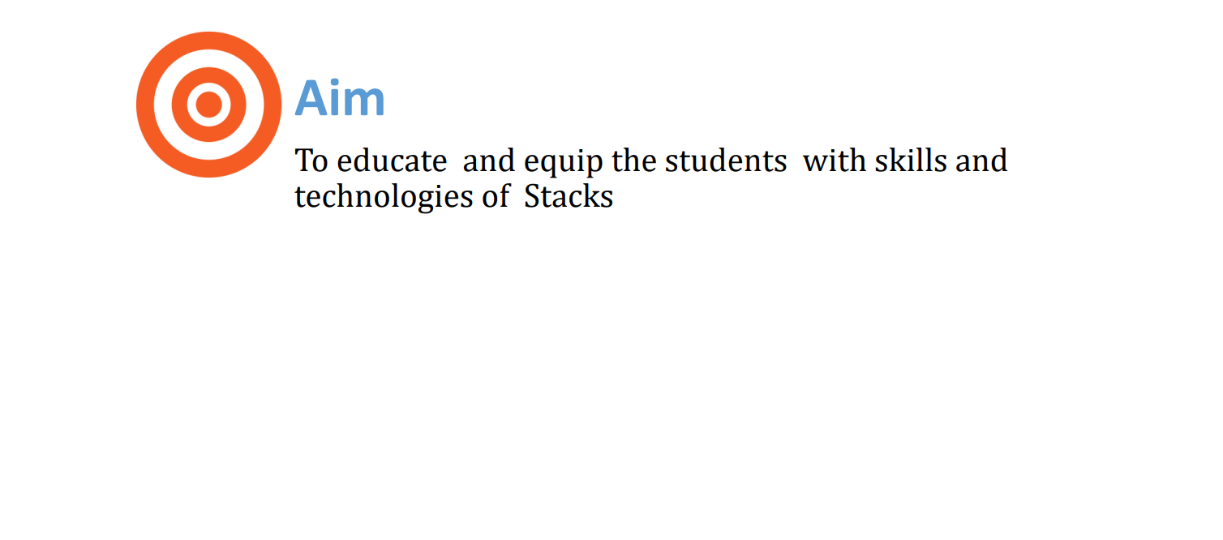

Slide 3
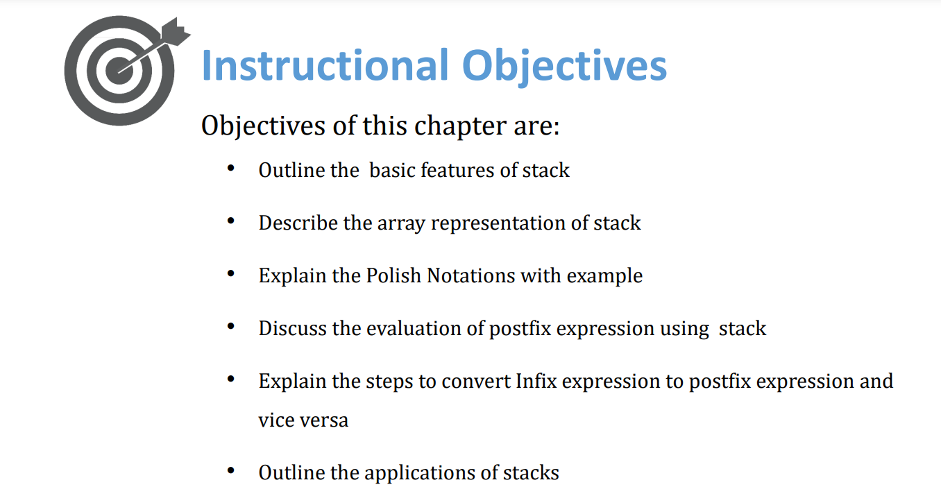

Slide 4
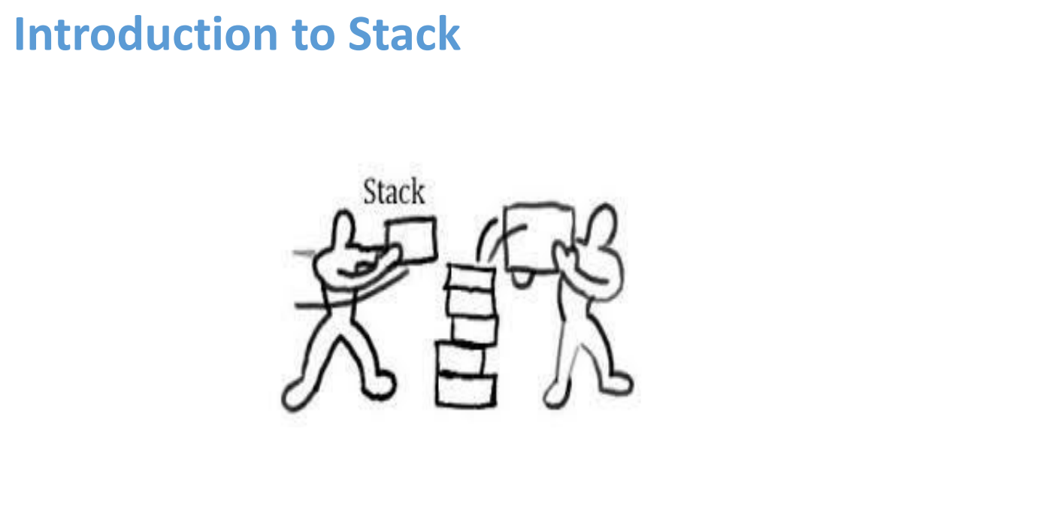

Slide 5
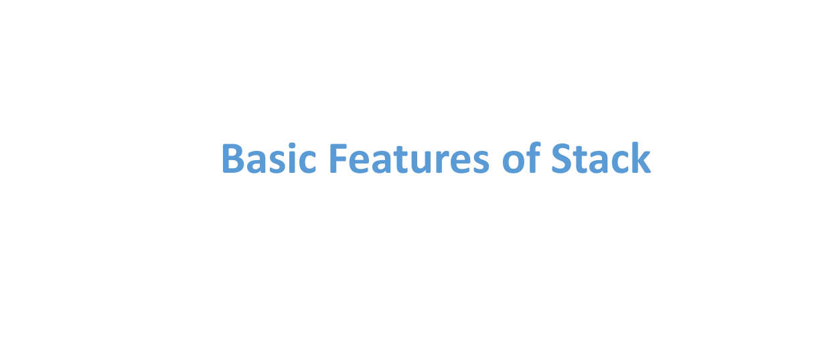

Slide 6
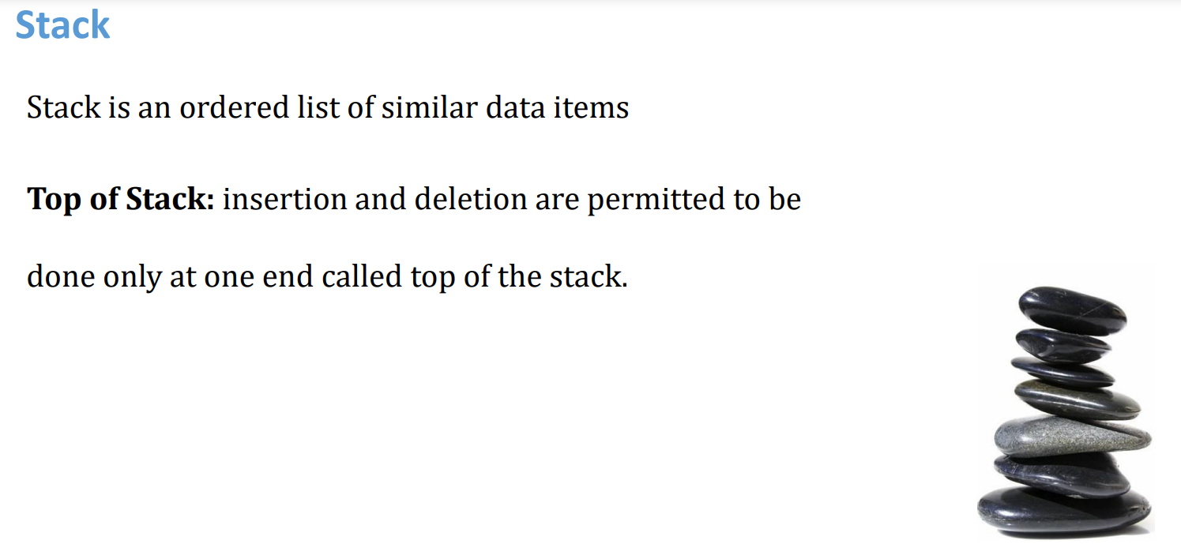

Slide 7
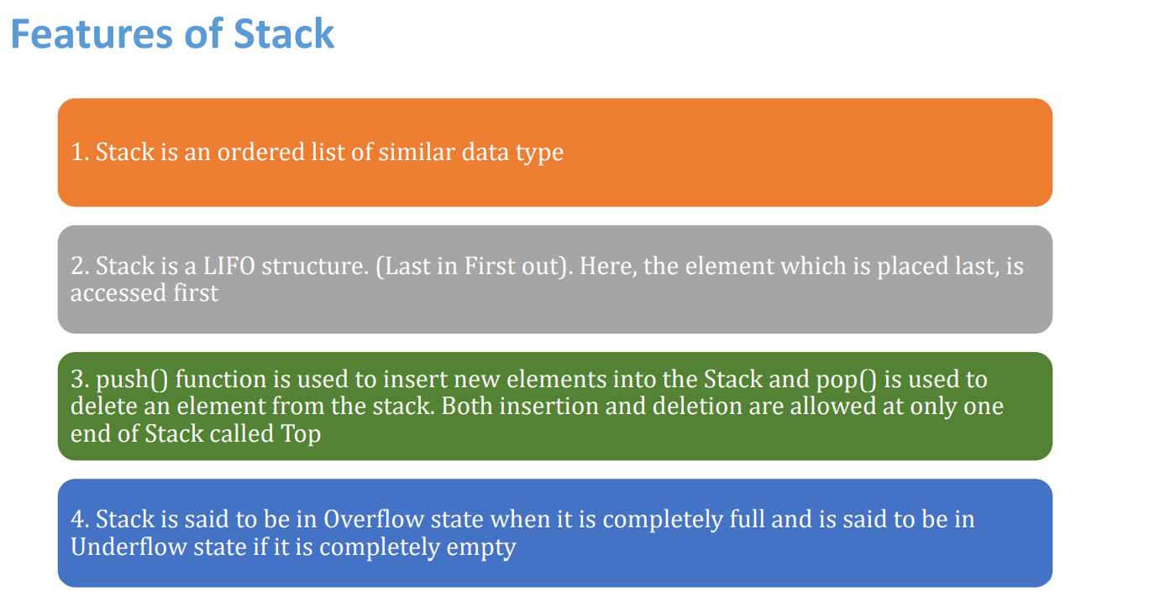

Slide 8
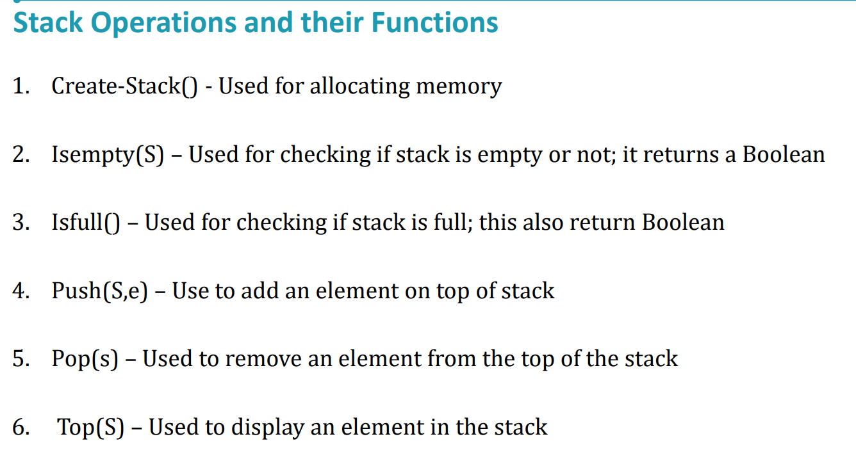

Slide 9
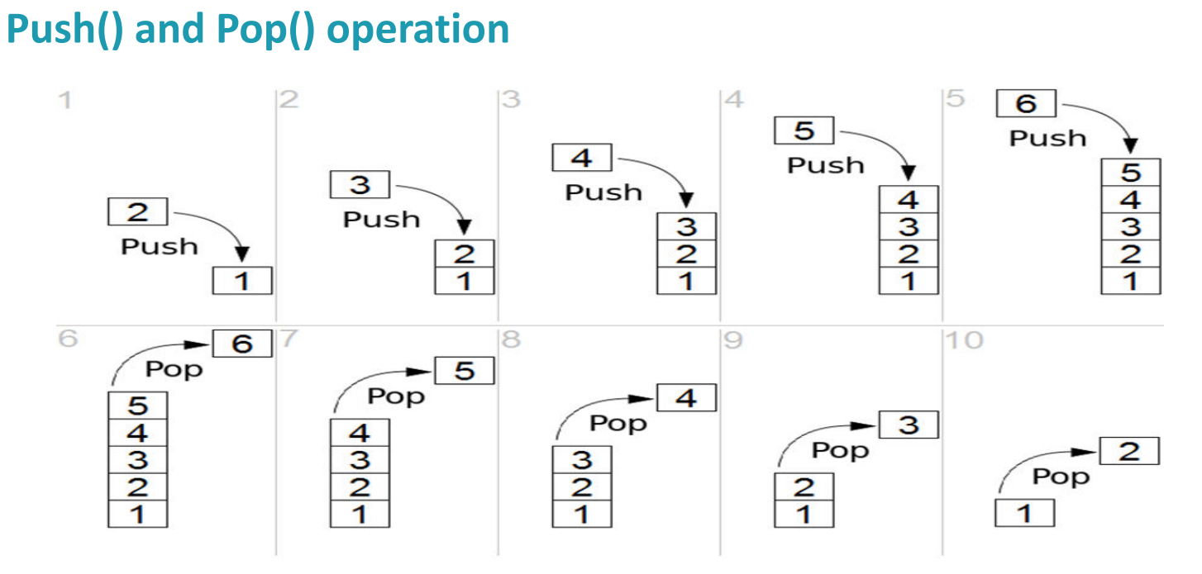

Slide 10
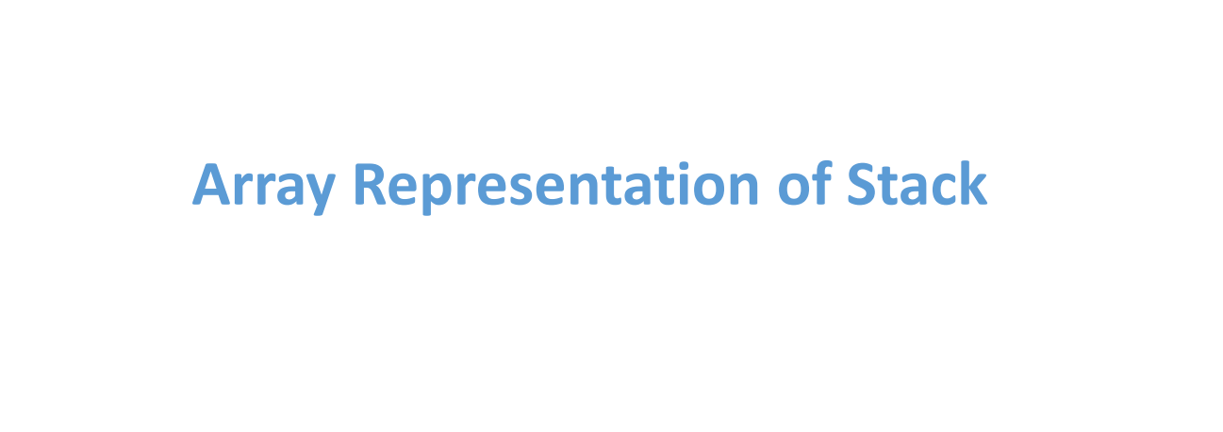

Slide 11
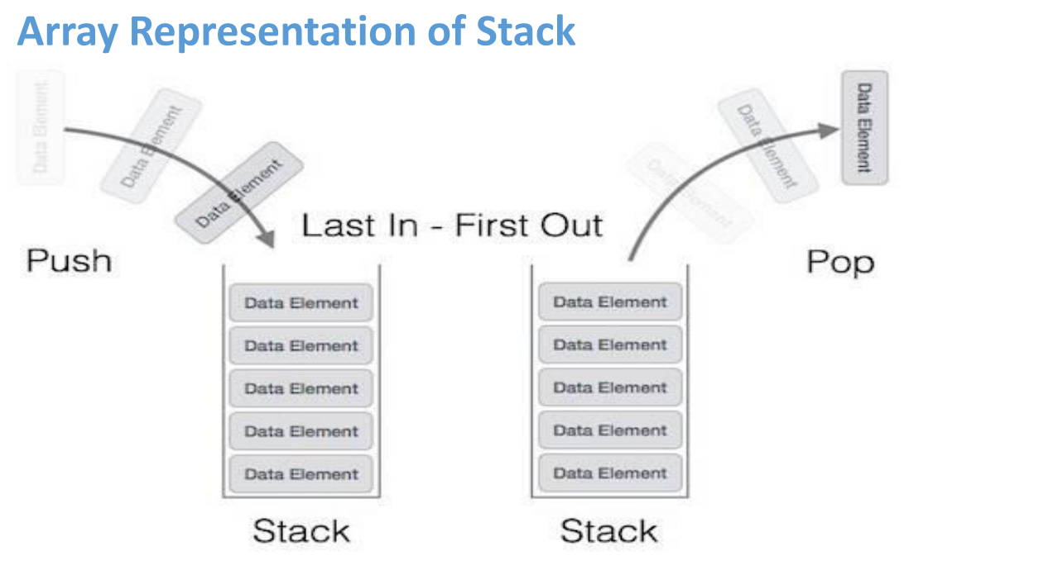

Slide 12
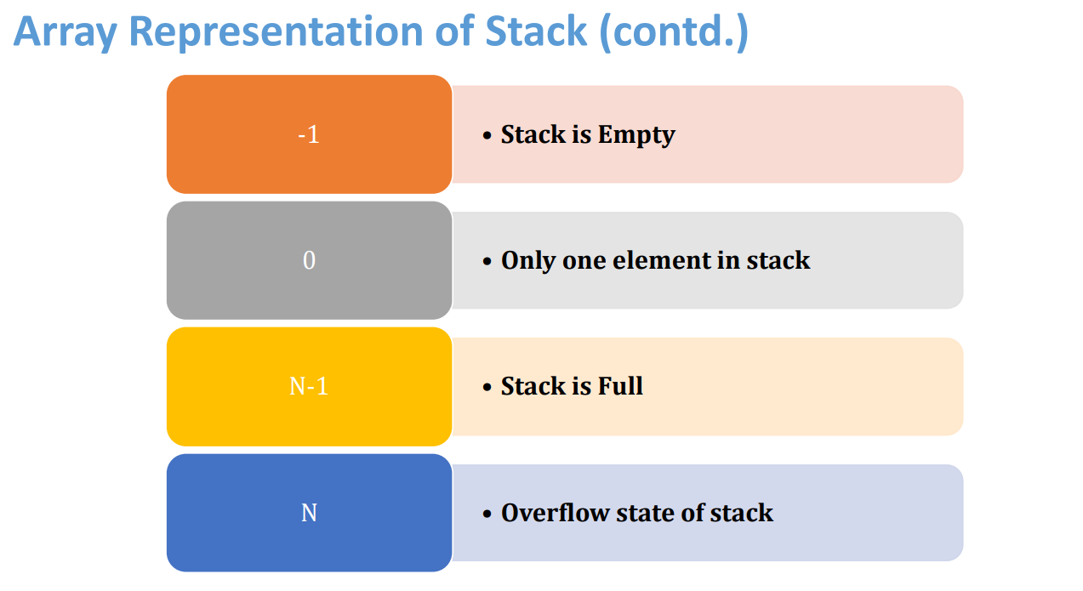

Slide 13
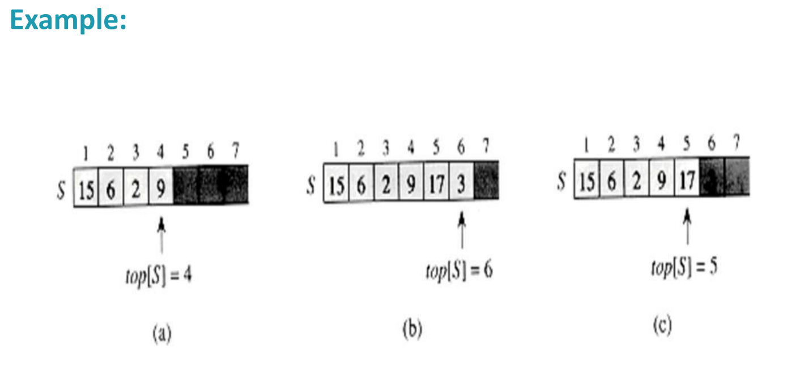

Slide 14
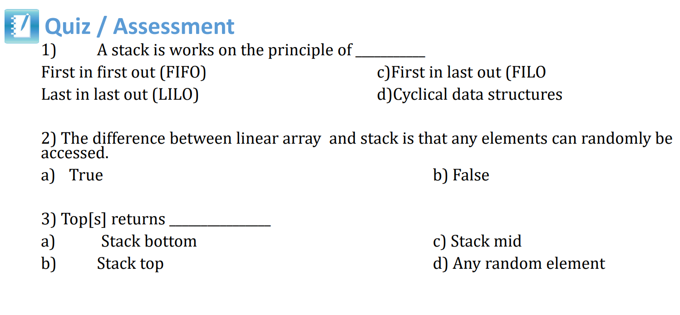

Slide 15
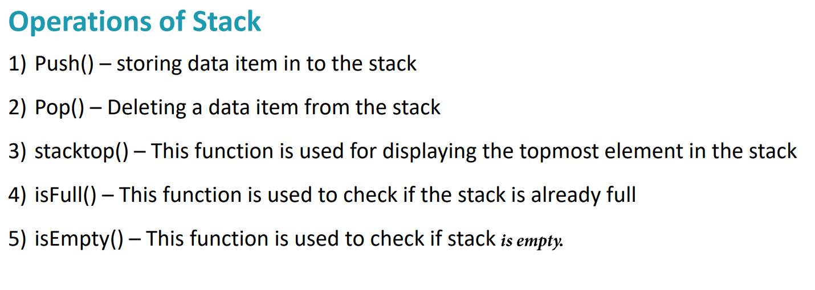

Slide 16
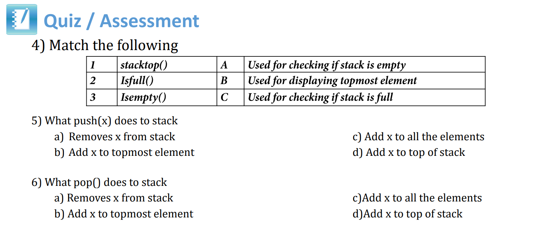

Slide 17
isfull()
Algorithm of isfull() function:
begin procedure isfull
if top = MAXSIZE
return true
else
return false
endif
end procedure

Slide 18
isempty()
Algorithm of isempty() function:
begin procedure isempty
if top < 1
return true
else
return false
endif
end procedure

Slide 19
Top:
Algorithm for TopStack()
begin
return stack[top]
end procedure

Slide 20
Push Operation
The process of putting a new data element onto stack is known as a Push Operation. Push operation involves following steps −
Step 1 − Checks if the stack is full.
Step 2 − If the stack is full, produces an error and exit.
Step 3 − If the stack is not full, increments top to point next empty space.
Step 4 − Adds data element to the stack location, where top is pointing.
Step 5 − Returns success.

Slide 21
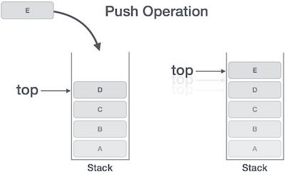

Slide 22
Algorithm for Push operation
PUSH(STACK, TOP, MAXSTK, ITEM)
1. [Stack already full]
If TOP=MAXSTK then
Print OVERFLOW and Return
2. Set TOP=TOP+1
3. STACK[TOP]=ITEM [Inserts the ITEM in new TOP position]
4. Return

Slide 23
Pop Operation
Accessing the content while removing it from the stack, is known as a Pop Operation.
In an array implementation of pop() operation, the data element is not actually removed, instead top is decremented to a lower position in the stack to point to the next value.

Slide 24
A Pop operation may involve the following steps −
Step 1 − Checks if the stack is empty.
Step 2 − If the stack is empty, produces an error and exit.
Step 3 − If the stack is not empty, accesses the data element at which top is pointing.
Step 4 − Decreases the value of top by 1.
Step 5 − Returns success.

Slide 25
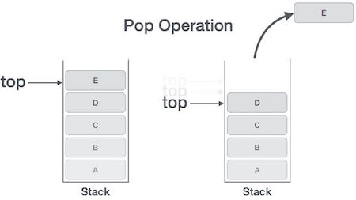

Slide 26
Algorithm for Pop operation
POP(STACK, TOP, ITEM)
1. [Stack has no items to be removed]
If TOP=0 then
Print UNDERFLOW and Return
2. Set ITEM=STACK[TOP]
3. Set TOP=TOP-1
4. Return

Slide 27
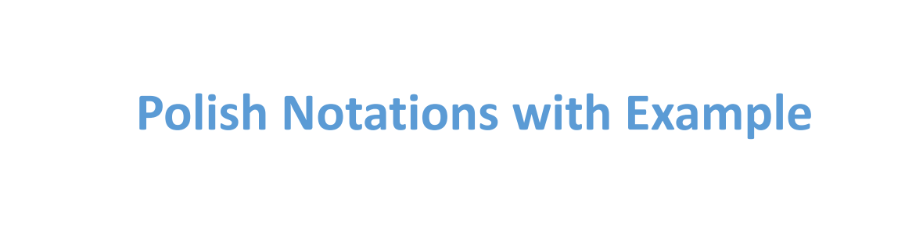

Slide 28
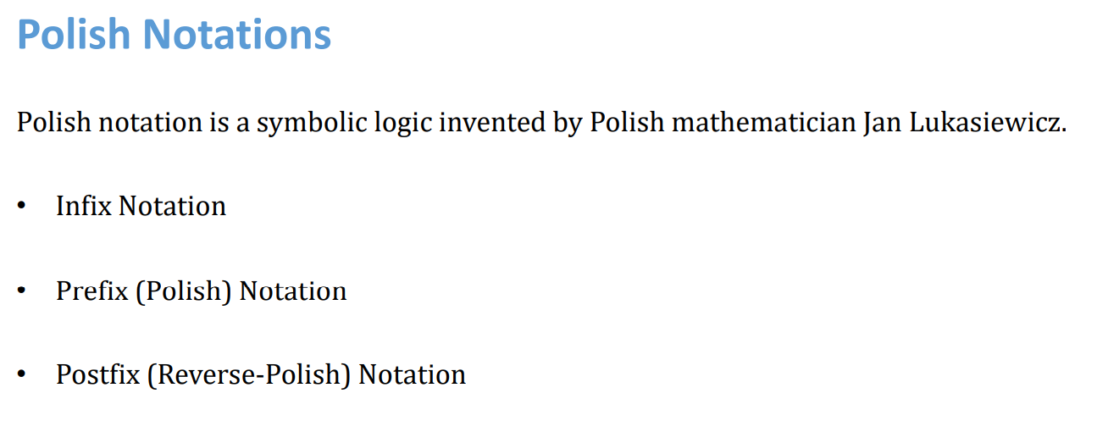

Slide 29
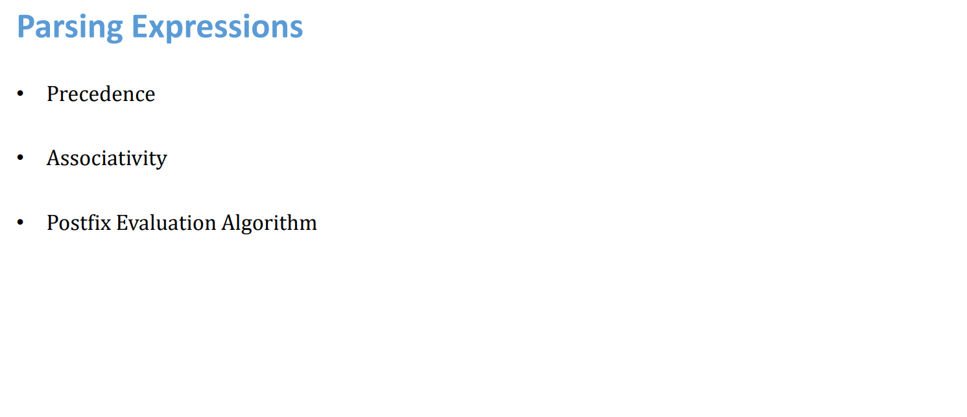

Slide 30
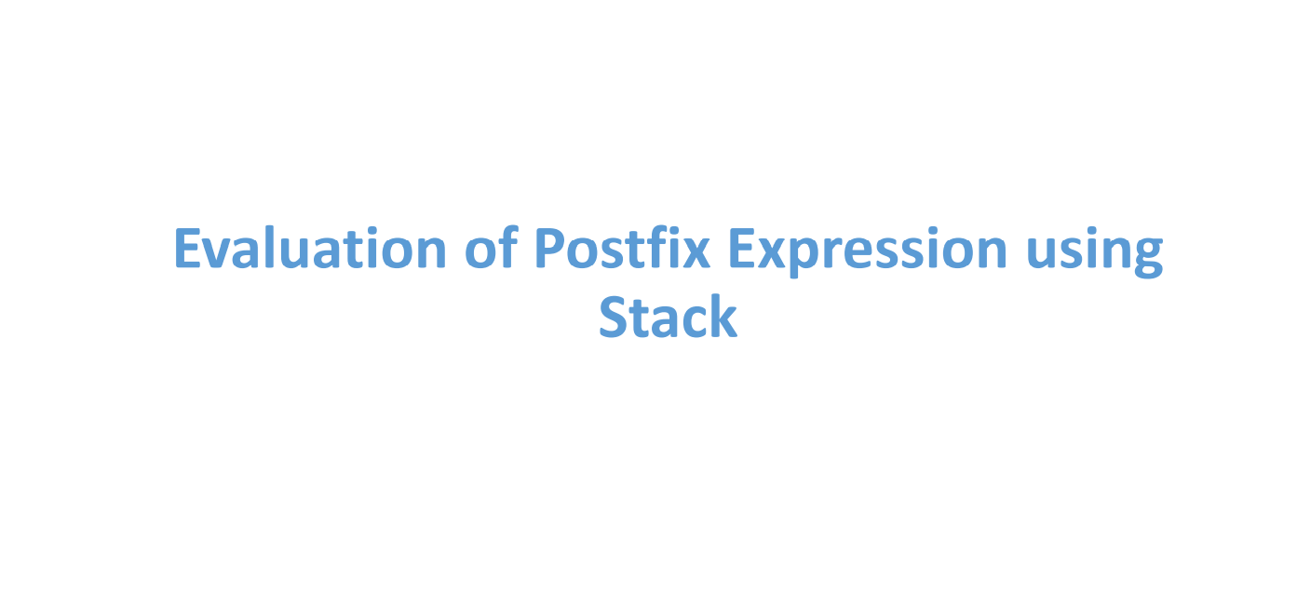

Slide 31
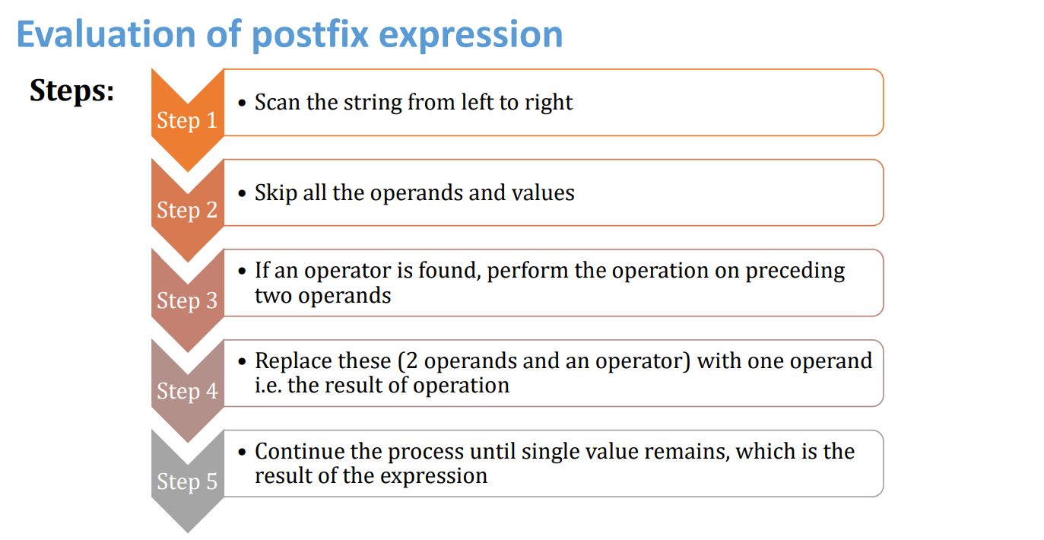

Slide 32
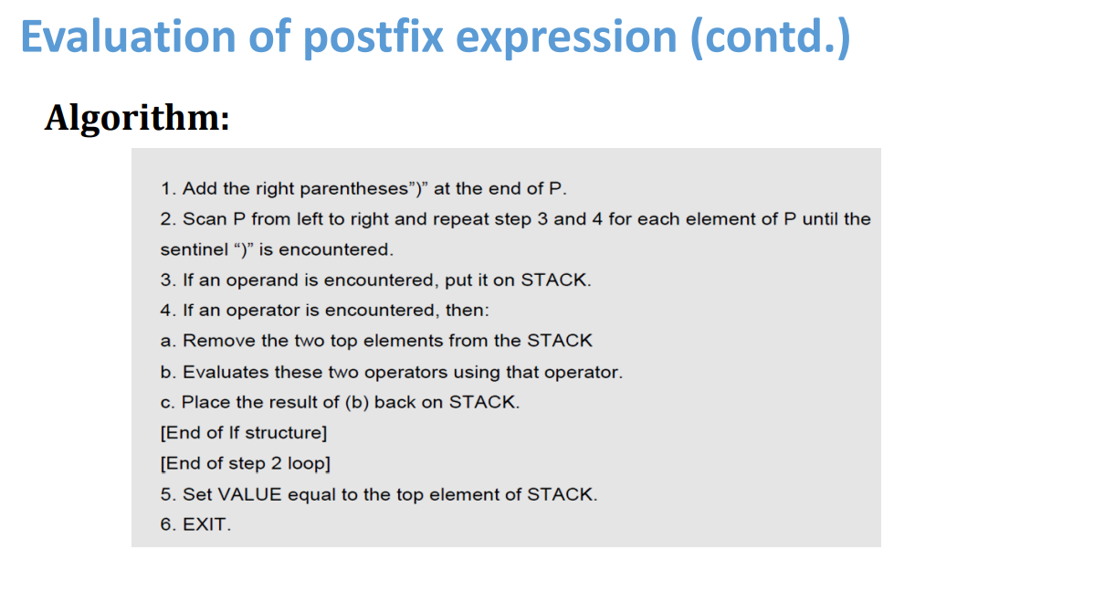

Slide 33
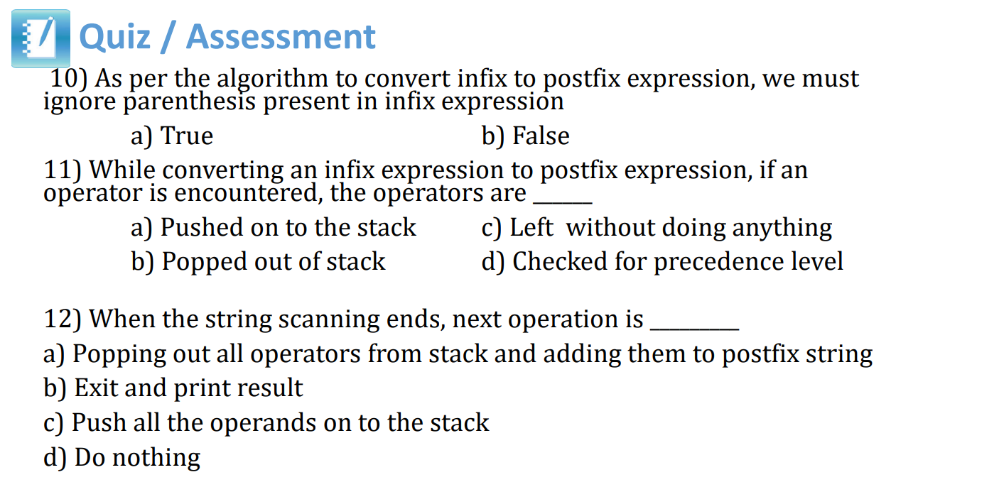

Slide 34
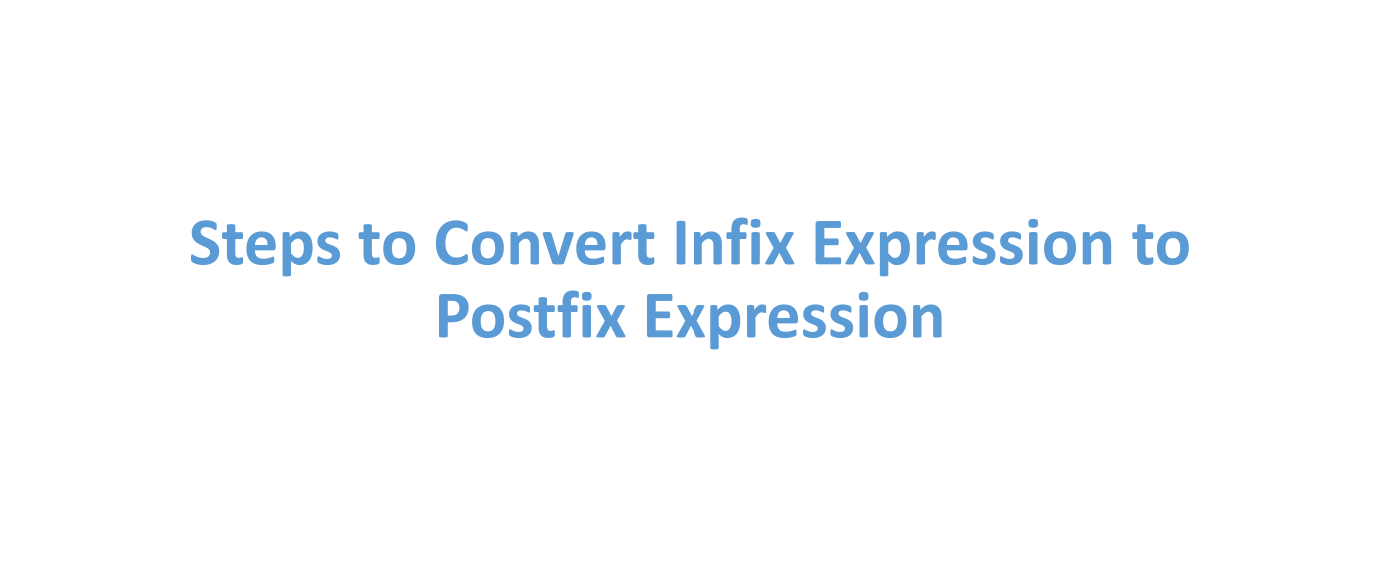

Slide 35
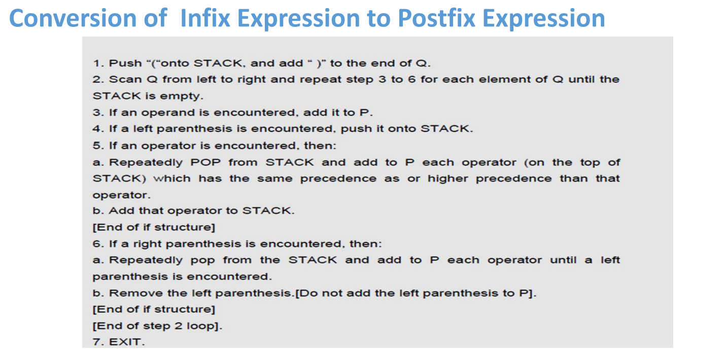

Slide 36
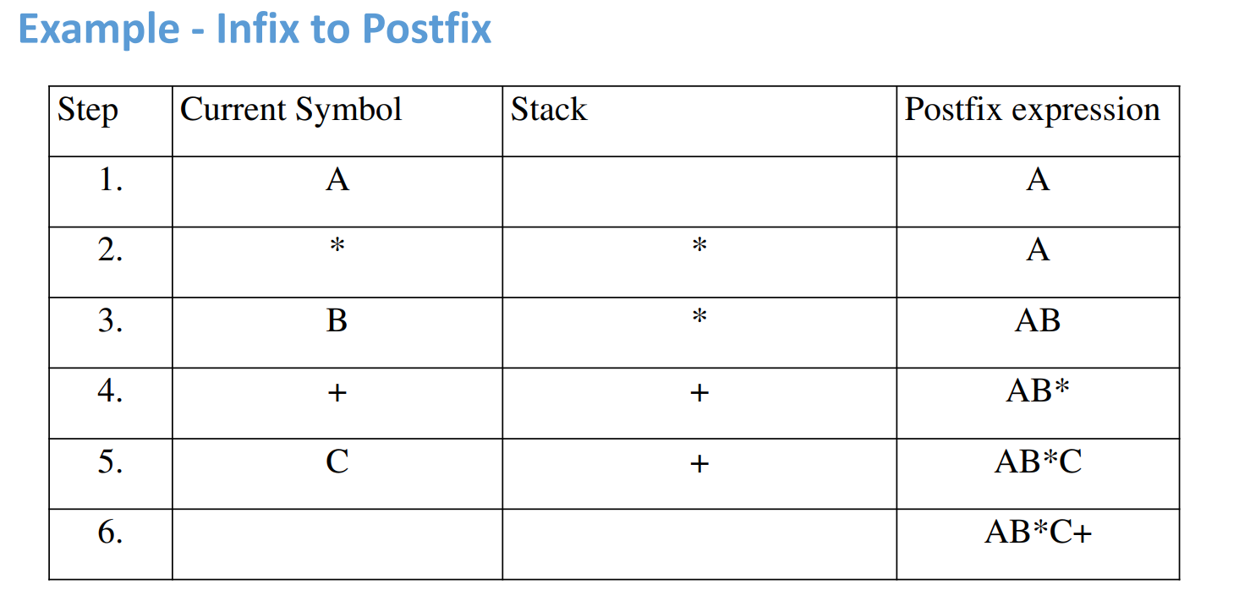

Slide 37


Slide 38
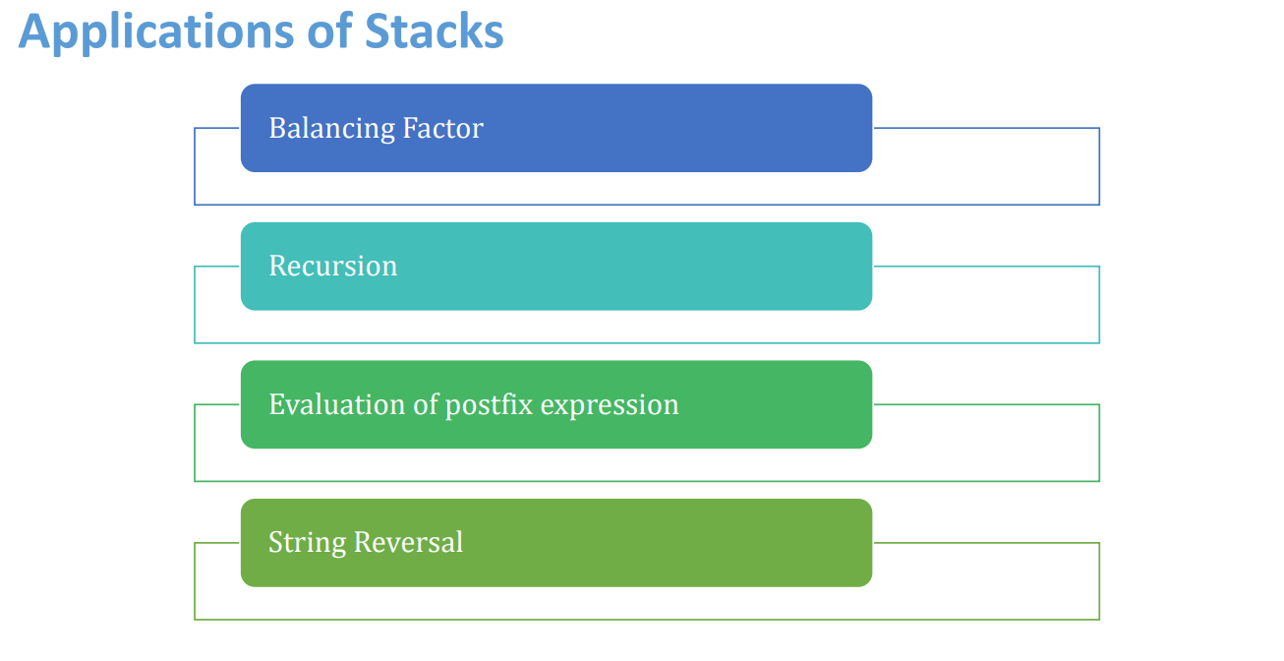

Slide 39
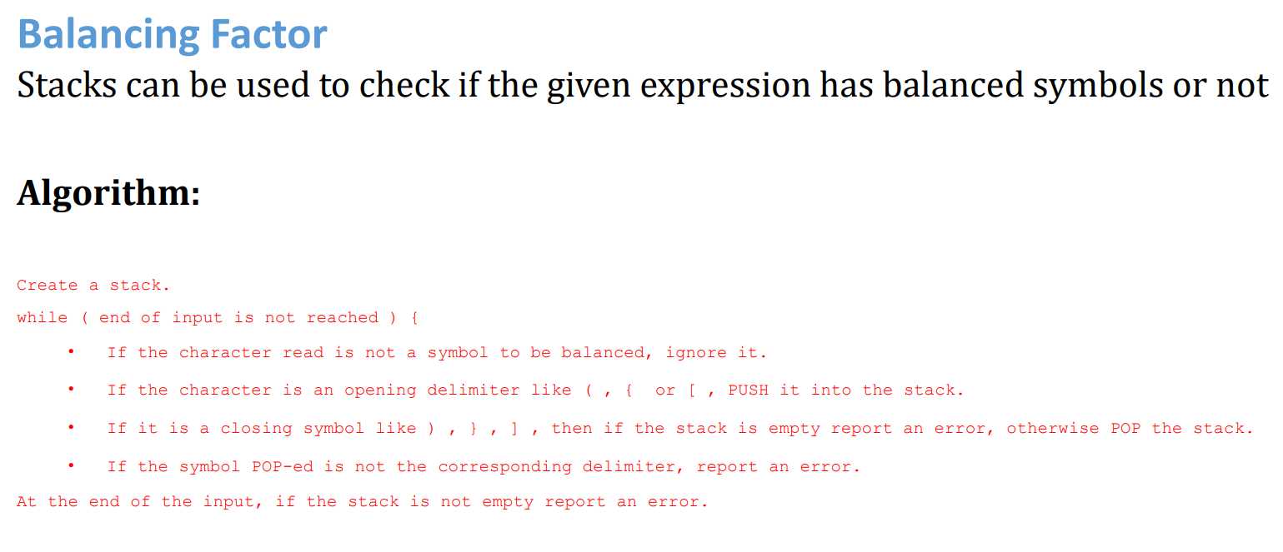

Slide 40
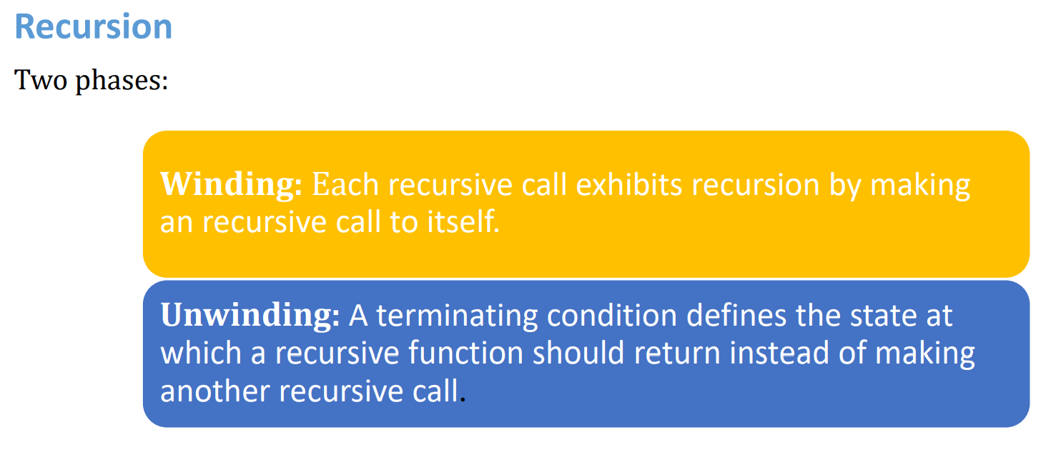

Slide 41
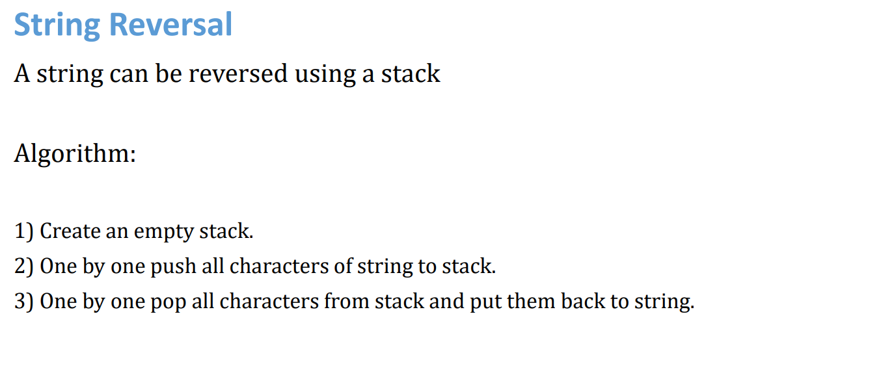

Slide 42
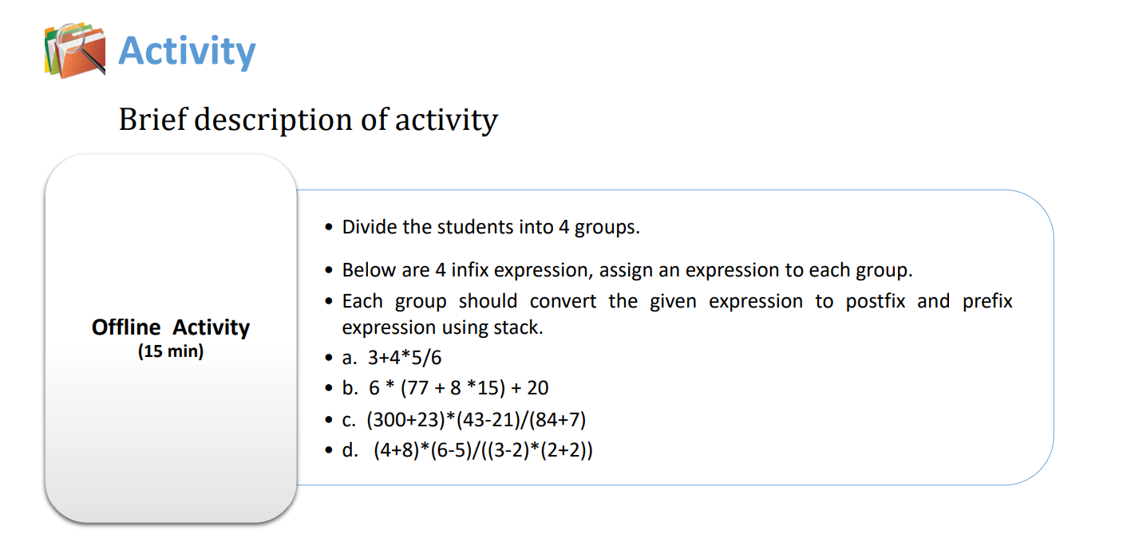

Slide 43
